Slide 1
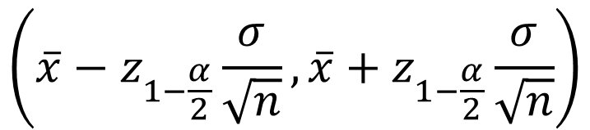
Confidence Intervals
(1-α)% CI for μ
$$\left(\overline{x}−z_{1−\frac{α}{2}}\frac{σ}{\sqrt{n}},\overline{x}+z_{1−\frac{α}{2}}\frac{σ}{\sqrt{n}}\right)$$
Known
I
II
n ≥ 25
This interval is based on Z where
~
But when σ is unknown we use
~
Read as
t-student distribution with n-1 degree of freedom
Dr. Abolfazl Saghafi
Assistant Professor of Statistics & Data Science
Data Science Program Director
T Confidence Intervals

Slide 2
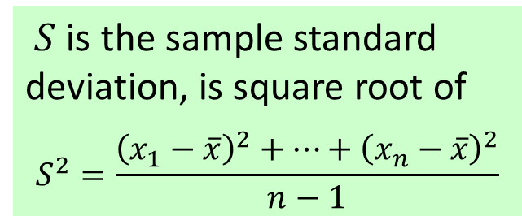
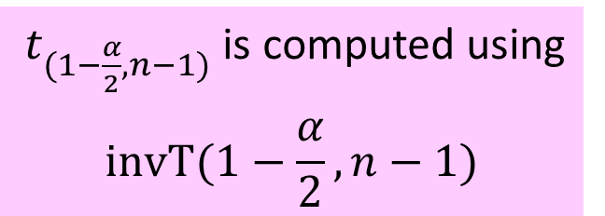
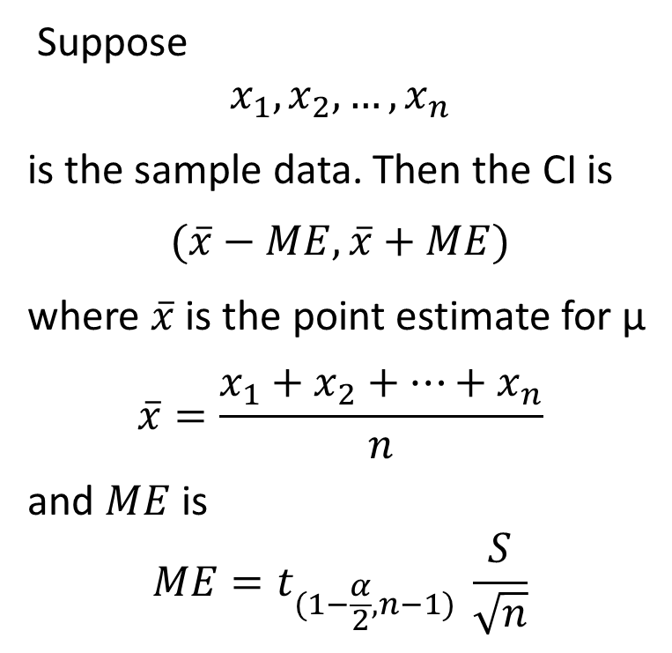
Population type III
$t_{(1−\frac{α}{2},n−1)}$ is computed using
$$invT(1−\frac{α}{2},n−1)$$
III
Suppose
$$x_{1},x_{2},…,x_{n}$$
is the sample data. Then the CI is
$$(\overline{x}−ME,\overline{x}+ME)$$
where $\overline{x}$ is the point estimate for μ
$$\overline{x}=\frac{x_{1}+x_{2}+…+x_{n}}{n}$$
and $ME$ is
$$ME=t_{(1−\frac{α}{2},n−1)} \frac{S}{\sqrt{n}}$$
$S$ is the sample standard deviation, is square root of
$$S^{2}=\frac{{\left(x_{1}−\overline{x}\right)}^{2}+…+{\left(x_{n}−\overline{x}\right)}^{2}}{n−1}$$
unknown
unknown
sample of size n
Notes:
We have a random phenomenon which we call X. We are interested in making inference about the general mean “μ” of this random phenomenon. If we know that X has a normal distribution with known variance (type I) OR if we know nothing about distribution of X but its variance is known and sample size is greater than or equal 30 (type II), then we build the (1-α)% CI using $(\overline{x}−ME,\overline{x}+ME)$ where $ME=z_{1−α/2} \frac{σ}{\sqrt{n}}$

Slide 3
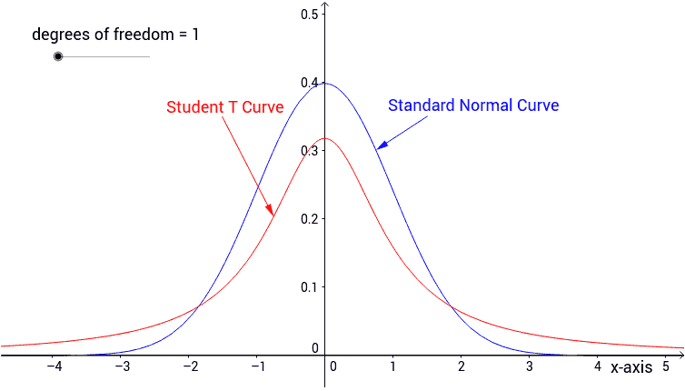
t-Student distribution
t-student is symmetric distribution with varying shape depending on its degree of freedom υ. In our cases, the degree of freedom is always (n-1).
As the sample size increases the degrees of freedom increases. Equivalently, the t-distribution approaches the standard normal distribution for large “n”.
Degrees of freedom is described as the number of scores that are free to vary.

Slide 4
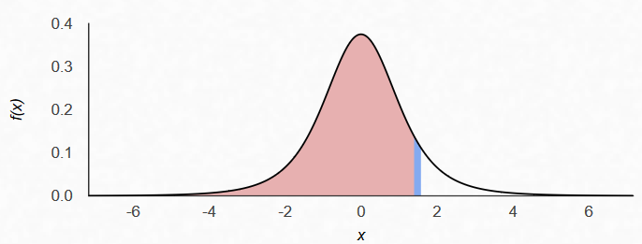
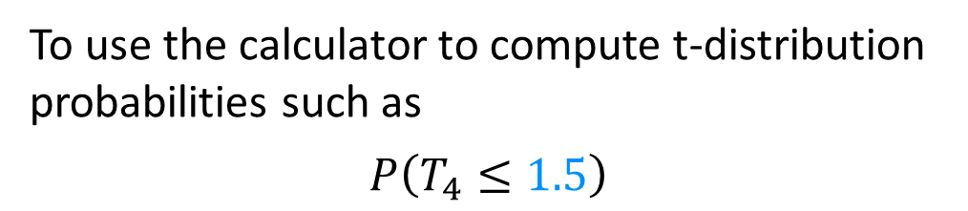

T Probabilities
To use the calculator to compute t-distribution probabilities such as
$$P\left(T_{4}≤1.5\right)$$
$$0.896$$
where it represents the area under a t-distribution with 4 degree of freedom, follow
Press 2nd and VARS [DISTR]
Scroll down to
5:tcdf(
Press ENTER
The syntax is tcdf(Lower,Upper,df)
The highlighted pink area spreads from -∞ to 1.5 corresponding to lower and upper bound.
Input -∞,1.5,4)
and press ENTER
to get the answer
The degree of freedom (df) for the curve is 4 which is the last entry for the tcdf function.
Notes:
T Probability refers to area under a specific T curve

Slide 5
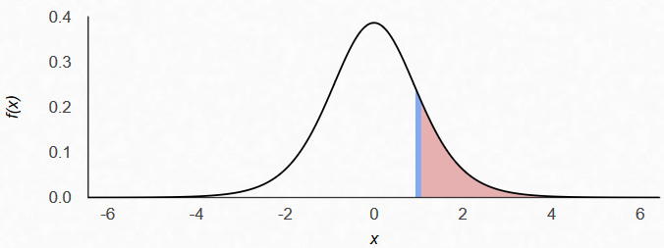
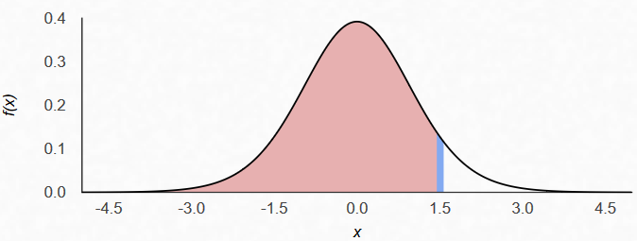
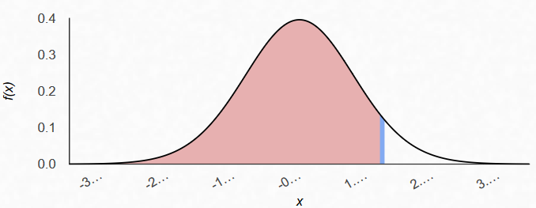
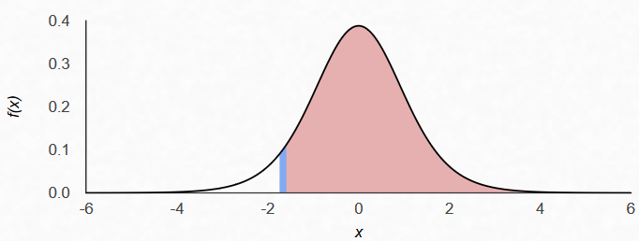
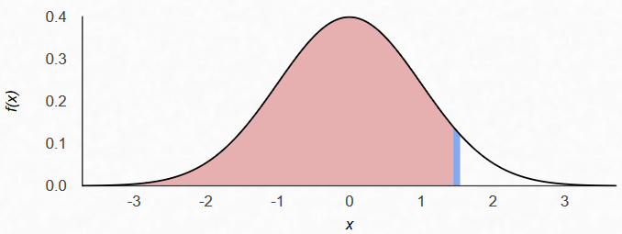






Examples
$$P\left(T_{8}>1.5\right)$$
$$P\left(T_{14}≤1.5\right)$$
0.086
0.92209
$$P\left(T_{9}≥−1.67\right)$$
$$P\left(T_{34}≤1.5\right)$$
0.92858
0.93537
$$P\left(Z≤1.5\right)$$
$$P\left(−0.5≤T_{13}≤1.5\right)$$
0.93319

Slide 6
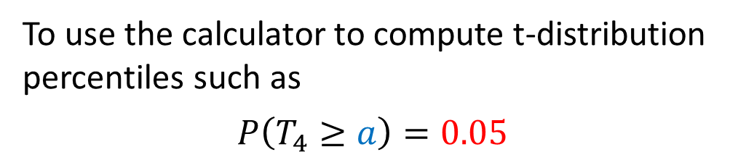


T Percentiles
If your calculator does not have invT function, find YouTube videos to program in into the calculator.
To use the calculator to compute t-distribution percentiles such as
$$P\left(T_{4}≥a\right)=0.05$$
$2.$13185
$$0.05$$
where it represents a number on the x-axis for a t-distribution with 4 degree of freedom, follow
Press 2nd and VARS [DISTR]
Scroll down to
4:invT(
Press ENTER
The syntax is invT(CumulativeProb,df)
The cumulative probability is a left tail area under the curve.
Enter 0.95,4)
and press ENTER
to get the answer
The degree of freedom (df) for the curve is 4 which is the last entry for the invT function.
Notes:
T Percentile refers to a threshold in a specific T curve which generates given probability

Slide 7
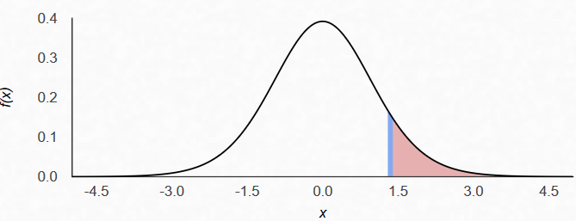
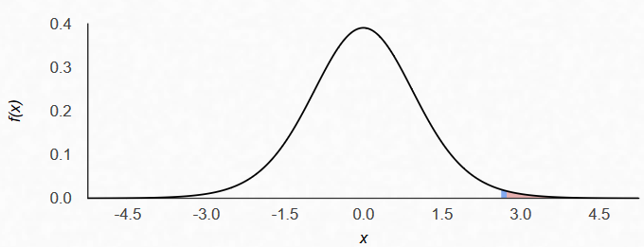
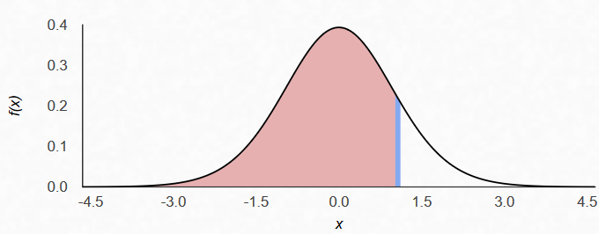






Examples
$$P\left(T_{14}≥a\right)=0.10$$
$$0.10$$
1.34503
$$P\left(T_{12}≥a\right)=0.01$$
$$0.01$$
2.681
$$P\left(T_{18}≤a\right)=0.85$$
1.06717
$0.$85

Slide 8
More Examples
a) With a sample size of 25, what is the t-value for a 90% confidence interval?
b) With a sample size of 9, what is the t-value for a 99% confidence interval?
c) With a sample size of 30, what is the t-value for a 95% confidence interval?
d) With a sample size of 30, what is the t-value for a 99% confidence interval?
Notes:
a) invT(0.95,24)=1.7108 since 1-α/2=0.95 and degree of freedom is n-1=24
b) invT(0.995,8)=3.2498
c) invT(0.975,29)=2.0452
d) invT(0.995,29)=2.7564

Slide 9

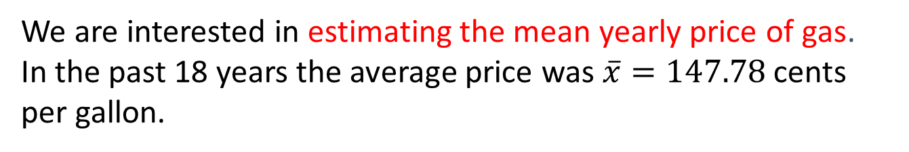
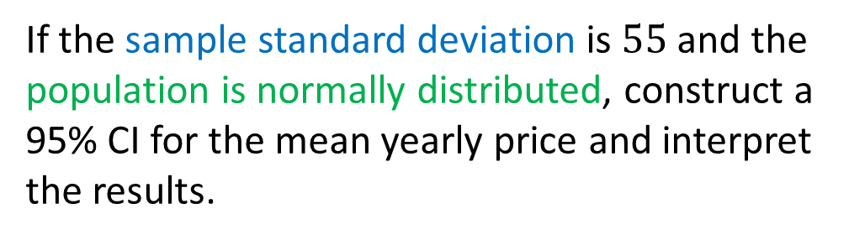
Example
We are interested in estimating the mean yearly price of gas.
In the past 18 years the average price was $\overline{x}=147.78$ cents per gallon.
If the sample standard deviation is $55$ and the population is normally distributed, construct a 95% CI for the mean yearly price and interpret the results.

Slide 10

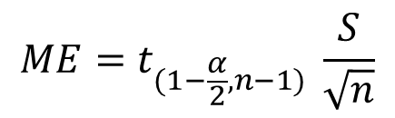



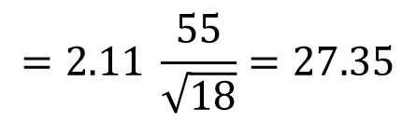


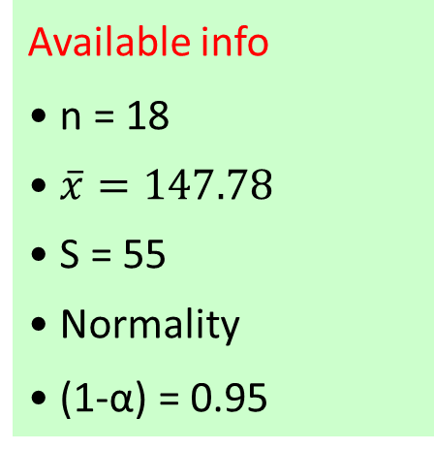


The random phenomenon is X: annual price of gasoline
We know that X ~ N( μ , σ = ?)
We would like to estimate μ: mean annual price USING SAMPLES
Available info
• n = 18
• $\overline{x}=147.78$
• S = 55
• Normality
• (1-α) = 0.95
The population type is ③ since distribution of gas price is normal and population standard deviation is unknown (we have its sample estimate). So
$$1−α=0.95$$
$$ME=t_{(1−\frac{α}{2},n−1)} \frac{S}{\sqrt{n}}$$
$$=2.11 \frac{55}{\sqrt{18}}=27.35$$
$$⇒ α=0.05$$
$$⇒ α/2=0.025$$
$$\left(\overline{x}−ME,\overline{x}+ME\right):$$
$$\left(147.78−27.35, 147.78 +27.35\right):$$
$$⇒1− α/2=0.975$$
$${\left(120.43, 175.13\right)}_{95\%}$$
$$⇒t_{(1−\frac{α}{2},n−1)}=t_{(0.975,17)}$$
With 95% confidence the annual mean price of gasoline is between 120.43 and 175.13
$$=invT\left(0.975,17\right)=2.11$$

Slide 11


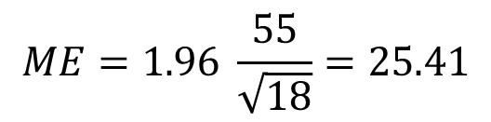



IF we used Z percentiles by mistake what would have happened?
Available info
• n = 18
• $\overline{x}=147.78$
• S = 55
• Normality
• (1-α) = 0.95
$$z_{1−α/2}=z_{0.975}$$
$$ME=1.96 \frac{55}{\sqrt{18}}=25.41$$
$$=invnorm\left(0.975\right)=1.96$$
$$\left(\overline{x}−ME,\overline{x}+ME\right):$$
$$\left(147.78−25.41, 147.78 +25.41\right):$$
$${\left(122.37, 173.19\right)}_{95\%}$$
The length of this interval is 50.82 which is shorter than the length of the correct t-interval 54.70
Using Calculator:
Press STAT and go to TESTS
Scroll down to 8:TInterval
Press ENTER
Select STATS
Input Xbar, Sx, n, C-Level=(0.95)
Press Calculate

Slide 12
Example
Use calculator to check your final answer
Given the following GPA for 6 students of a class and using the fact that the GPA distribution is normal
2.80, 3.20, 3.75, 3.10, 2.95, 3.40
a) Calculate a 95% confidence interval for the mean GPA of the class.
b) Interpret the result.
c) If the confidence level is increased from 95% to 99% , will the length of the confidence interval increase, decrease, or remain the same?
d) If the confidence level is kept at 95% but the sample size is quadrupled to n=24, do you expect the length of the confidence interval to increase, decrease, or remain approximately the same?

Slide 13



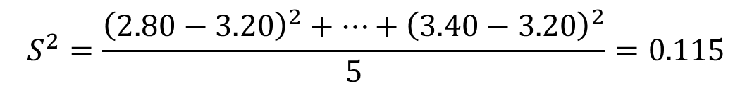
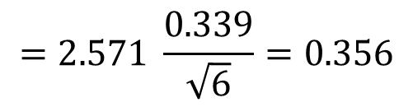
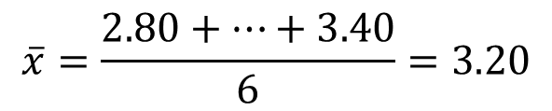
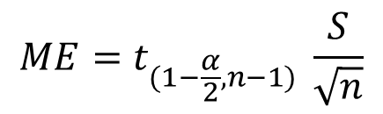


The random phenomenon is X: GPA for students of a class
We know that X ~ N( μ , σ = ?)
We would like to estimate μ: mean GPA
Available info
• normality
• n = 6 sample data
$$\overline{x}=\frac{2.80+…+3.40}{6}=3.20$$
First, we need to compute the point estimate:
$$S^{2}=\frac{{\left(2.80−3.20\right)}^{2}+…+{\left(3.40−3.20\right)}^{2}}{5}=0.115$$
Then, the sample variance:
And, sample standard deviation:
$$S=\sqrt{0.115}=0.339$$
Next, the t-percentile:
$$t_{(1−\frac{α}{2},n−1)}=t_{(0.975,5)}$$
$$=invT\left(0.975,5\right)=2.571$$
$$ME=t_{(1−\frac{α}{2},n−1)} \frac{S}{\sqrt{n}}$$
$$=2.571 \frac{0.339}{\sqrt{6}}=0.356$$
Finally, the ME and the Interval:
$$\left(\overline{x}−ME,\overline{x}+ME\right):$$
$${\left(2.84, 3.56\right)}_{95\%}$$
b) With 95% confidence the mean GPA of students in the class is between 2.84 and 3.56
Notes:
c) Increasing the confidence level while the sample size is fixed will result in the increasing of CI length.
d) Decreases.

Slide 14
Example
In order to estimate the average age of patients with breast cancer in the US, a sample of 50 patients with breast cancer is selected at random.
The data reveals a point estimate of 65 years with a standard deviation of 10 years. Assuming that the ages of the breast cancer patients follow normal distribution, obtain a 90% confidence interval for the mean age of a breast cancer patient. Interpret your answer.
(𝟔𝟐.𝟔𝟖,𝟔𝟕.𝟑𝟐)

Slide 15
Example
Given a random sample of 16, a sample mean of 100 and a population standard deviation of 12, find the margin of error at the 95% degree of confidence, assuming normality. (Ans: 5.88)
Given a random sample of 25, a sample mean of 52.4 and a sample standard deviation of 7.4, find the margin of error at the 90% degree of confidence, assuming normality. (Ans: 2.53)
Find the critical value of t-student distribution for the following CIs.
a) n=8, 99%
b) n=30, 99%
c) n=23, 90%
d) n=23, 80%
Notes:
a) 3.4995 b) 2.7564 c) 1.7171 d) 1.3212

Slide 16

Practice Problems Part 2
1. In some mining operations, a byproduct of the processing is mildly radioactive. Of prime concern is the possibility that release of these byproducts into the environment may contaminate the freshwater supply.
A random sample of 42 specimens of water from a city’s water supply gave a mean of 5.39 pCi/L and a standard deviation of 0.92 pCi/L. Based on this information compute a 90% confidence interval for the true mean concentration of radioactive particles in the city’s water supplies. Assume normality.
Notes:
Answers are provided in Ch6 Practice Problem Solutions

Slide 17

Practice Problems Part 2
2. A horticulturist wishes to estimate the mean growth of seedlings in a large timber plot. A random sample of n = 100 seedlings is selected and the one-year growth for each is measured.
The sample results in a mean of 5.62 cm and a standard deviation of 2.50 cm. Assuming a normal distribution for the one-year growth of seedlings, compute the 95% confidence interval for the mean growth.
Notes:
Answers are provided in Ch6 Practice Problem Solutions

Slide 18

Practice Problems Part 2
3. In an investigation on toxins produced by molds that infect corn crops, a biochemist prepares extracts of the mold culture and then measures the amount of the toxic substance per gram of solution.
From six preparations of the mold culture the following observations on toxic substances (mg) are obtained:
1.2, 0.8, 0.6, 1.1, 1.2, 0.8
Compute a 90% confidence interval for the mean amount of toxic substances. Assume normal distribution for the amount toxin.
Notes:
Answers are provided in Ch6 Practice Problem Solutions

Slide 19

Practice Problems Part 2
4. Recently, a price war has developed among retailers selling Brand X denim jeans. A major chain buyer wishes to estimate the mean price of these jeans during this period to compare it to the normal selling price of $20.00.
A random sample of 7 major retailers produces a mean retail price of $13.50 with a standard deviation of $3.50. Assuming a normal distribution for the price of these jeans, compute an 80% confidence interval for the true mean retail price of Brand X jeans during the price war.
Notes:
Answers are provided in Ch6 Practice Problem Solutions

Slide 20

Practice Problems Part 2
5. A tire dealer claims his competitor's tires won't last 40,000 miles, on average. The competitor sues the dealer and the courts order the dealer to back up his claim with statistical evidence or pay a fine.
They instruct the dealer to purchase 36 of the competitor's tires and run them until they fail to pass the DMV test. The dealer follows the instructions and ends estimating from the sample an average of 39,300 miles with a standard deviation of 2,500 miles. Based on this information compute a 99% confidence interval for the true mean tire mileage.
Notes:
Answers are provided in Ch6 Practice Problem Solutions

